Slide 1
Self Determination
Statewide Self Advocacy Network
Adapted from information by Regional Offices 10 & 4.
1/29/15

Slide 2
The Idea
People with disabilities should have ultimate authority to decide how money designated to support them should be spent.

Slide 3
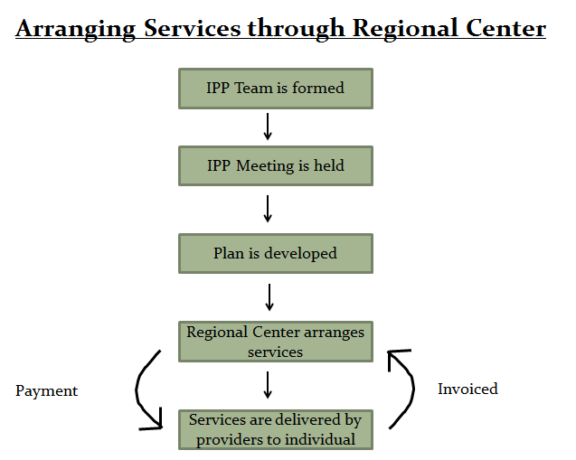
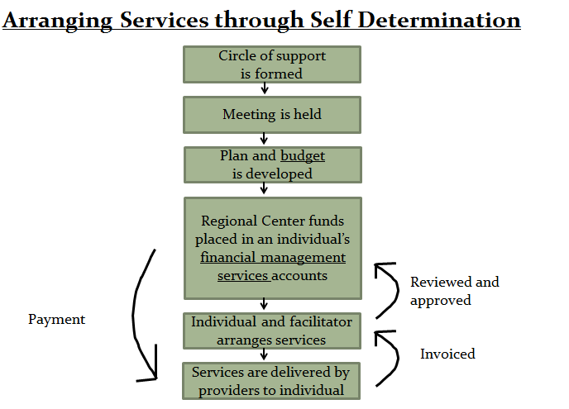

Slide 4
How It Works
The amount of your Individual Budget (IB) is based on how much regional center spent on your services over the last 12 months.
Your budget pays for FMS and Facilitator
With the help of people you trust, you develop a Person-Centered Plan (PCP) that reflects your vision in the different areas of your life and set goals.
Based on the PCP an IPP that identifies the goals and the budget for the services to be purchased.
The DDS funds are not to replace SSI/SSA benefits nor pay for housing or cost of living. Rather it is to fund the services and supports to live independently in the community while remaining healthy and safe.

Slide 5
The Five Principles of Self Determination
Freedom
Authority
Support
Responsibility
Confirmation

Slide 6
The Five Principles of Self Determination
Responsibility: for the wise use of public money, and recognizing the contributions you can make to your community.

Slide 7
Who Can Get Self Determination?
Anyone who receives services from a regional center is eligible for Self Determination services, except for people who live in a licensed, long-term health facility such as a developmental center or an Intermediate Care Facility. If you are in the process of moving into the community, then you ARE eligible for self determination services.
To receive Self Determination, you must attend a required Self Determination orientation, receive training on how Self Determination works, and agree to work with a Fiscal Management Service.

Slide 8
Who is Involved?
Individual – the leader.
The circle of support, your friends, family, paid supports, etc.
Facilitator – if you want one, assist with developing and implementing the self determined plan and services.
Fiscal Manager – handles the money, vendored by regional center.
Regional Center Service Coordinator – new role. Oversee, monitor plan, revise if needed.

Slide 9
Financial Management Service (FMS)
You must use a FMS to be in Self Determination.
Receives funds from regional center that are allocated in the person’s budge. Funds are placed in an account.
Makes payments to service providers, vendored and non-vendored.
Keeps track of services provided and back up documentation.
Maintains financial records.
Can be the employer of record. Takes care of taxes, workers’ compensation, liability insurance, and makes sure all provider legal requirements are met (i.e. licenses and certification).
Reports on expenditures to regional center.
The FMS does NOT make decisions about how your money is spent.

Slide 10
The Facilitator
Helps the person with their Person-Centered Plan.
Helps plan and maintain the individualized budget.
Helps the person develop a network of support and be part of their community.
Helps find providers, negotiates rates, hours of service, and working agreements, and makes sure providers live up to the agreements made.
Helps work out issues with providers.
Helps the person and those around him or her to honor and live by the principles of Self-Determination.
You pay for the facilitator out of your budget. The individual or family members can facilitate plans. It’s up to the individual.

Slide 11
Traditional Services vs. Self Determination
Person wants Awesome Therapy (AT).
Person has tried all programs offered and none meet needs. Person has letters from doctors to back up request for AT.
Service coordinator says AT isn’t “vendored” and takes request to “committee.” 3 weeks later person gets a denial letter saying AT isn’t vendored, is too expensive, and person doesn’t need AT anyway.
Person appeals denial and could wait up to 50 days for a decision - and might lose.
Person wants AT.
Person makes sure there’s enough money in budget to pay for AT.
Person talks with AT and comes to an agreement about hours & rate.
Person gives hours & rate info to FMS who makes sure AT has required certification and that staff don’t have criminal records.
Person starts receiving AT.
Whole process takes a few days.

Slide 12
Phase in and the status of the Wavier

Slide 13
If wanting Self Determination…
Have Self Determination included in your IPP. If a list exist at the regional center, get on it. Send an email to DDS to get on their list. Having Self Determination in your IPP or name on a list, it won’t guarantee that you will get it as soon as it’s available. But it could improve your chances.
Learn as much as you can about Self Determination. Attend trainings. Read about Self Determination. Be aware of waiver status and roll out date.
Share what you learn about Self Determination with others who might be interested.

Slide 14
For More Information…
Department of Developmental Services:
http://www.dds.ca.gov/SDP/index.cfm
You can sign up for email updates about self determination If you want to be notified when updates are made, please email sdp@dds.ca.gov and ask to be included on the notification list.
Disability Rights California SD Publication: http://www.disabilityrightsca.org/pubs/F07701.pdf
The Center for Self-Determination: http://www.centerforself-determination.com/
Senate Bill 468: http://www.leginfo.ca.gov/pub/13-14/bill/sen/sb_0451-0500/sb_468_bill_20131009_chaptered.pdf

