Slide 1
Regional Center Services for Consumers with Developmental Disabilities James F. Huyck Public Benefits Consultant/Advocate jfhuyck@yahoo.com (916) 529-5300

Slide 2
Regional Centers
Created under the Lanterman Act
Non-profit private corporations (parent/consumer Boards)
Contract with the Department of Developmental Services (DDS)
Provide or coordinate services and supports for individuals with developmental disabilities

Slide 3
Regional Center Philosophy
Primary goals are to provide services and support necessary to allow children with developmental disabilities to remain with their families and for adults to achieve the highest level of normalization possible
There are currently 21 Regional Centers with more than 40 offices throughout the state

Slide 4
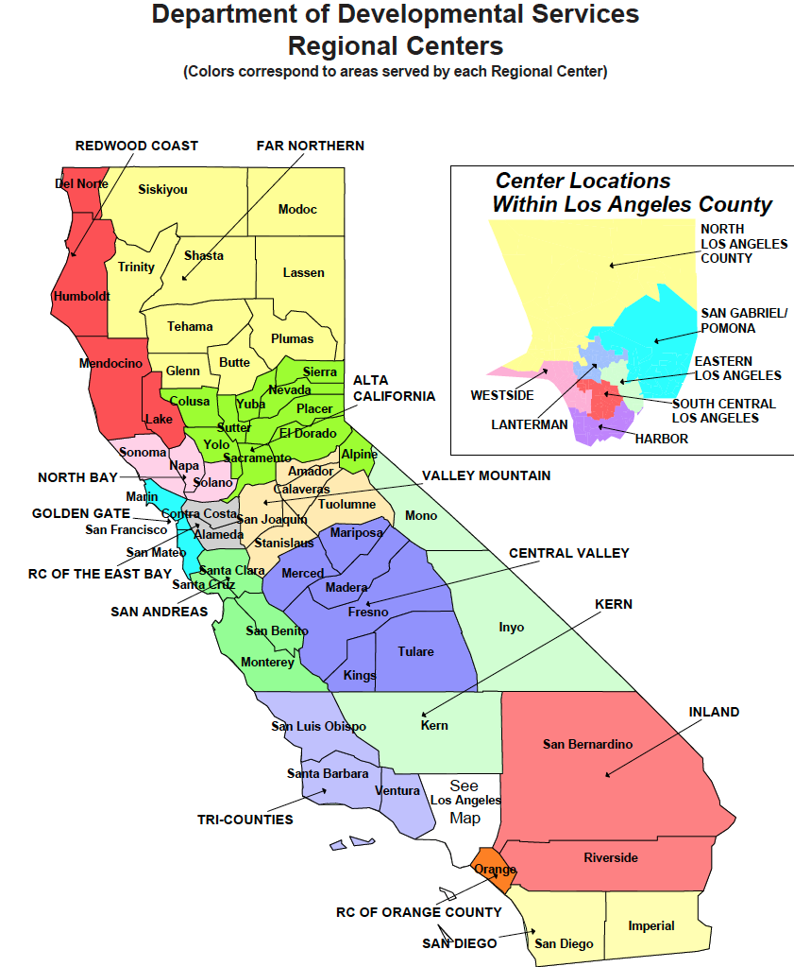

Slide 5
Eligibility for Regional Center Services
Eligibility is determined solely on meeting the definition of “Developmental Disability”
There is no income or asset test
This program is unique to California

Slide 6
Regional Centers Administer 2 Programs
Early Start/Early Intervention
Children age zero to 3
“Over 3 services”
Children over 3, through adulthood

Slide 7
EARLY START/EARLY INTERVENTION ELIGIBILITY
Children younger than 3 years with exceptional needs who are at risk of becoming developmentally disabled or who have a developmental delay may qualify for services.

Slide 8
Early Intervention Services
Based on the child's assessed developmental needs early intervention services may include:
occupational therapy
physical therapy
speech and language services

Slide 9
Definition of Developmental Disability (over 3 services)
Determined just prior to age 3
Lanterman Act defines developmental disability to mean:
A disability which begins before age 18,
Is expected to continue indefinitely, and
Constitutes a substantial disability for the individual.

Slide 10
Definition of Developmental Disability
A Developmental Disability includes an intellectual disability, cerebral palsy, epilepsy, autism or a disabling condition closely related to an intellectual disability or requiring treatment similar to that required for individuals with an intellectual disability.

Slide 11
Disabilities that are NOT a Developmental Disability
Definition expressly excludes other handicapping conditions that are solely learning disabilities, psychiatric disorders or physical in nature
Does allow for “dually-diagnosed” individuals

Slide 12
Substantial Disability
Substantial Disability – significant functional limitation in 3 or more of the following:
Self Care
Receptive and expressive language
Learning
Mobility
Self-direction
Capacity for independent living
Economic self-sufficiency

Slide 13
Regional Centers Responsibilities
Regional Centers do not provide direct services, instead they identify, approve and fund community services (vendorization)
Regional Centers must pursue all possible sources of funding before accessing regional center funds. For example, generic agencies such as private insurance, education, MediCal, and IHSS
Regional centers are considered to be the “payer” of last resort

Slide 14
Regional Center Services
Services are to be determined through the Individual Program Plan (IPP) process
Services in the IPP are “the Entitlement”
Philosophy is to provide services that will allow a consumer's life to approximate that of his or her same-aged non-disabled peers
Services may vary from one center to the other

Slide 15
IPP Planning Team
Consumer (if an adult)
Parent (if a child) or Conservator (if an adult)
Service Coordinator or other Regional Center Representative
Can also include:
Other family members
Friends/neighbors/co-workers
Service Providers/Support Persons
Or any Individual invited by the consumer or Authorized Representative

Slide 16
Required Components of IPP
Assessment
For the specific service/support requested
Goals
Objectives
Services and Supports to achieve the goals and objectives (whether funded by RC or not)

Slide 17
Individual Family Service Plan/Individual Service Plan
Developed in conjunction with the vendor of services
More detailed than the Individual Program Plan (IPP)
Reviewed at least annually
Regional Center Representative usually attends

Slide 18
PARENTAL FEES (CHILDREN AGE 0 THROUGH 17)
Family Cost Participation Program
Annual Family Program Fee
Parental Financial Responsibility Program

Slide 19
FAMILY COST PARTICIPATION PROGRAM
Children who receive three specific regional center services:
Day Care or Respite
Applies if child:
is zero through 17 years
lives in the parents' home.
is not eligible for Medi-Cal.

Slide 20
FAMILY COST PARTICIPATION PROGRAM
Examples of cost for family of 4
0% - income lower than $97,000
10% - income of $97,000
60% - income of $204,000
100% - income of $243,000
Again, no fee if child is on MediCal

Slide 21
Annual Family Program Fee
For children ages 0-18
Examples for family of 4 with annual income:
Under $97,000 – $0 fee
$97,000 to $200,00 - $150 fee
Over $200,000 - $200
Families of children assessed a cost under the Family Cost Participation Program will not be charged a fee.
No fee if child is on MediCal

Slide 22
Parental Financial Responsibility Program
Parents of children under the age of 18
who receive 24-hour out–of-home services
are required to pay a fee depending on their ability to pay
Payable even if the child is on MediCal

Slide 23
Examples for family of 4
Annual gross income of $45,000 - Monthly Fee= $0
Annual gross income of $55,978 - Monthly Fee of $140
Annual gross income of $113,138 - Monthly Fee of $471
Annual gross income of $141,747 - Monthly Fee of $709

Slide 24
An adult Consumer of the Regional Center is not Responsible to Pay for Services
Special Needs Trust issue
Administrative Law Judge Decision

Slide 25
Institutional Deeming onto MediCal
If not eligible for SSI-linked MediCal
Process:
Regional Center Consumer (3 to 18) is funded for at least 1 service
Regional Center places child onto DDS MediCaid Waiver
Requests the local MediCal agency to Institutionally Deem the child
Only child’s income and resources are considered
Allows for In Home Support Services

Slide 26
Regional Center Services (based upon assessed need/not a menu)
Residential/living options:
Board and Care
Intermediate Care Facilities (MediCal funded)
Supported Living Services
Family Home Agency
Foster Family Agency
Independent Skills Training

Slide 27
Regional Center Services
In Home Respite
Out of home Respite
Transportation services
Adult Day Program services
Supported Employment
Behavioral Services
Required to access private health insurance

Slide 28
Due Process
Informal Meeting
Meet with Regional Center Rep not involved with original decision
Recommended as first step
Mediation (voluntary/non binding)
Can resolve issue
Confidential Settlement possible
Formal Fair Hearing (Administrative Law Judge)

Slide 29
Q and A ? Regional Center Services for Consumers with Developmental Disabilities James F. Huyck Public Benefits Consultant/Advocate jfhuyck@yahoo.com (916) 529-5300

